Slide 1
Introduction to Neural Networks*
Pranjal Chaubey
FB SPAIC Scholar
FB Dev C Scholar
*Content taken from Udacity DLND unless stated otherwise

Slide 2

Agenda
You’d know it, if you sit through the presentation.

Slide 3
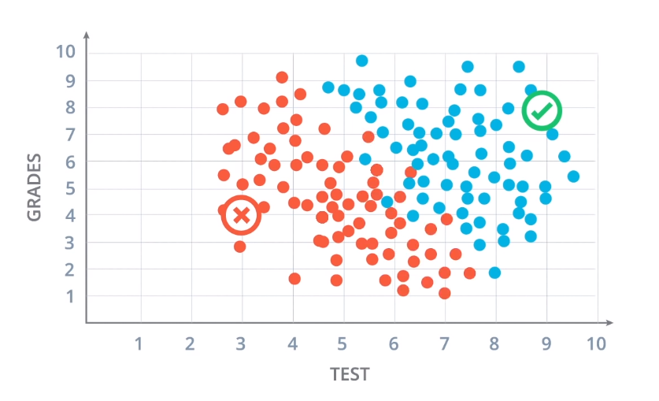
Understanding what NNs actually do
Let’s look at a University application dataset
Grades - student grades in school
Test - student scores in entrance test
Blue got accepted
Red got rejected

Slide 4
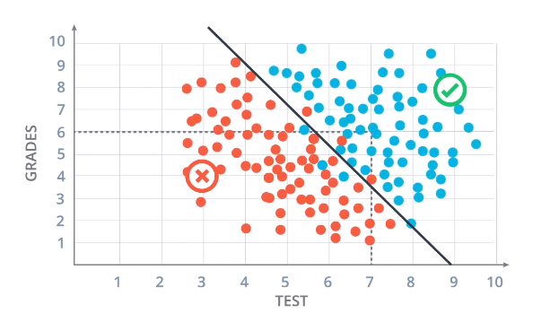
Understanding what NNs actually do
Separate the dataset into two parts
Students that got selected
Students that got rejected

Slide 5
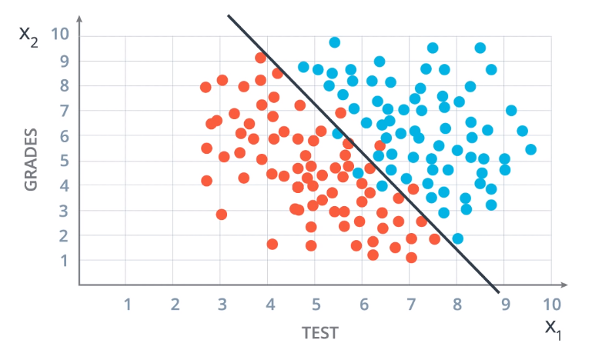
Understanding what NNs actually do
Let’s define the equation of line in a Neural Network-sy way
Input Data
Y-axis - Student Grades
X-axis - Student Test Score
Reimagine it
Y-axis - Student Grades - x2
X-axis - Student Test Score - x1

Slide 6
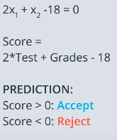
Understanding what NNs actually do
Let’s define the equation of line in a Neural Network-sy way

Slide 7
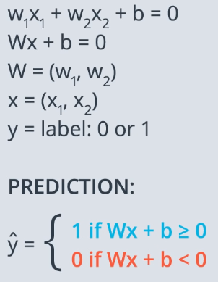
Understanding what NNs actually do
Let’s define the equation of line in a Neural Network-sy way
*This line is also called a Decision Boundary

Slide 8
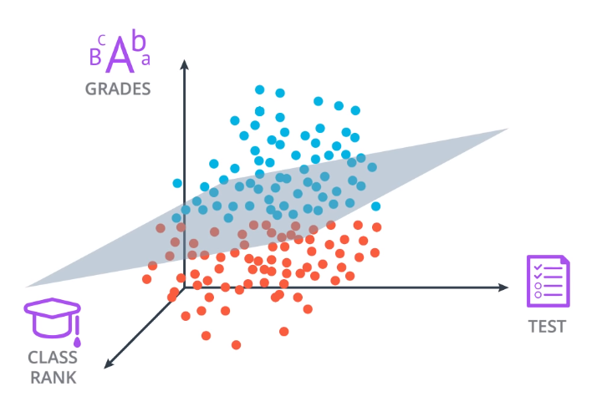
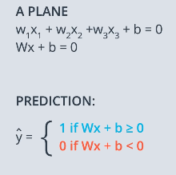
Understanding what NNs actually do
What if there was more data?

Slide 9
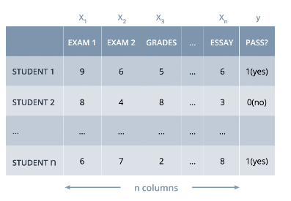
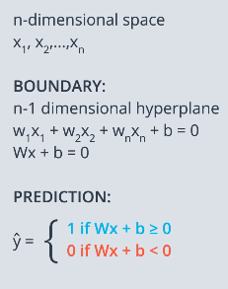
Understanding what NNs actually do
What if there was more data?

Slide 10
Understanding what NNs actually do
In NN Lingo,
x1, x2, ….., xn - Features
Y - Target (that we are trying to predict)

Slide 11
Understanding what NNs actually do
Let’s make this equation look super cool

Slide 12
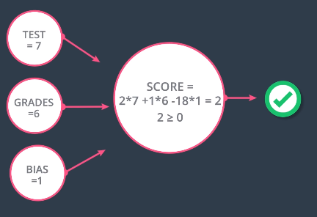
Understanding what NNs actually do
Let’s make this equation look super cool*
*Notice that inequality - That’s our activation function

Slide 13
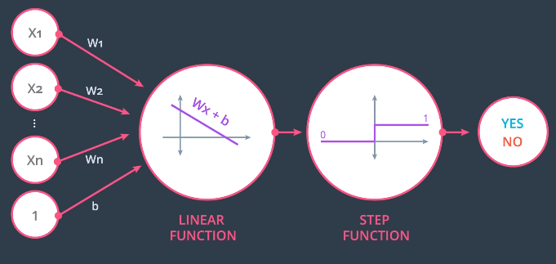
Understanding what NNs actually do
Let’s make this equation look super cool

Slide 14
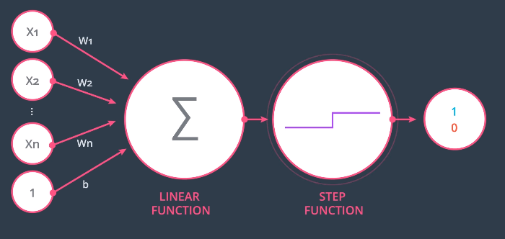
Understanding what NNs actually do
Let’s make everything harder to understand

Slide 15
Understanding what NNs actually do
And this, my friends, is how I met the Perceptron!

Slide 16

Understanding what NNs actually do
And this, my friends, is how I met the Perceptron!

Slide 17
Understanding what NNs actually do
Now we want a mechanism to find this line automatically.
Now we want a mechanism to find this line automagically!!!
Now we want a mechanism to LEARN THE VALUE OF WEIGHTS w1 w2.
Now we want the machine to do Machine Learning.

Slide 18
Understanding what NNs actually do
Now we want a mechanism to find this line automatically.
Now we want a mechanism to find this line automagically!!!
Now we want a mechanism to LEARN THE VALUE OF WEIGHTS w1 w2.
Now we want the machine to do Machine Learning.

Slide 19
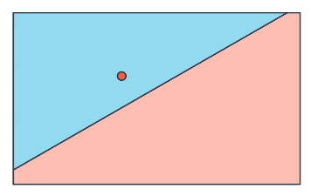
Understanding what NNs actually do
Let’s imagine a single datapoint that has been misclassified

Slide 20
Understanding what NNs actually do
Let’s imagine a single datapoint that has been misclassified
Should the line/decision boundary go farther or come closer to it?

Slide 21
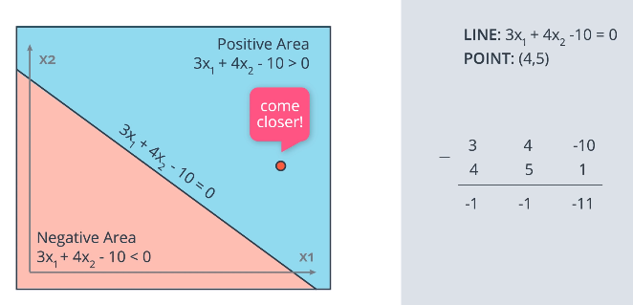
Understanding what NNs actually do
Put some numbers out there

Slide 22
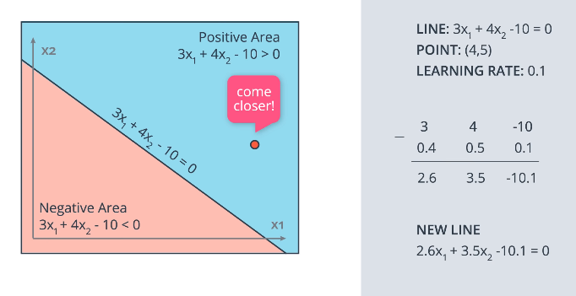
Understanding what NNs actually do
Put some numbers out there

Slide 23
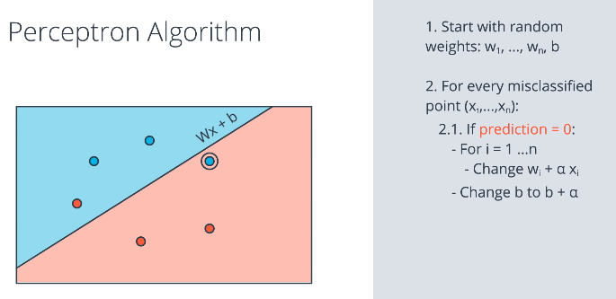
Understanding what NNs actually do
Put some numbers out there

Slide 24
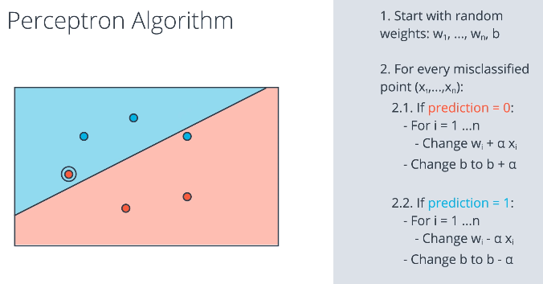
Understanding what NNs actually do
We are just finding the best set of weights!

Slide 25
Understanding what NNs actually do
I have a dataset

Slide 26
Understanding what NNs actually do
I have a dataset
I have a perceptron

Slide 27
Understanding what NNs actually do
I have a dataset
I have a perceptron
I have the line

Slide 28
Understanding what NNs actually do
dataset-perceptron-line-dataset

Slide 29

Understanding what NNs actually do
dataset-perceptron-line-dataset

Slide 30
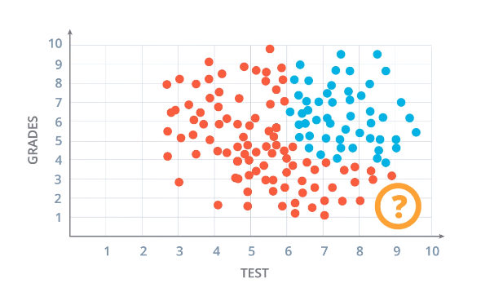
Understanding what NNs actually do
Over work is not over yet. There’s a catch!
What if our data is NOT LINEARLY SEPARABLE?

Slide 31
Understanding what NNs actually do
Over work is not over yet. There’s a catch!
What if our data is NOT LINEARLY SEPARABLE?
How about we combine multiple perceptrons now?

Slide 32
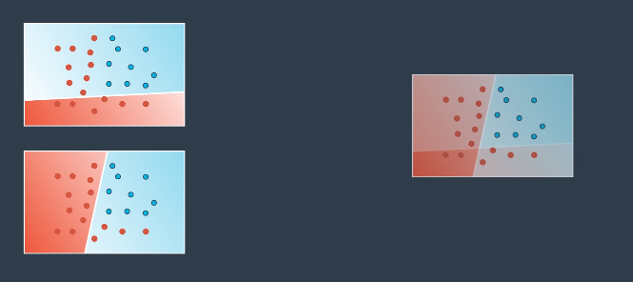
Understanding what NNs actually do
Combining Multiple Perceptrons

Slide 33
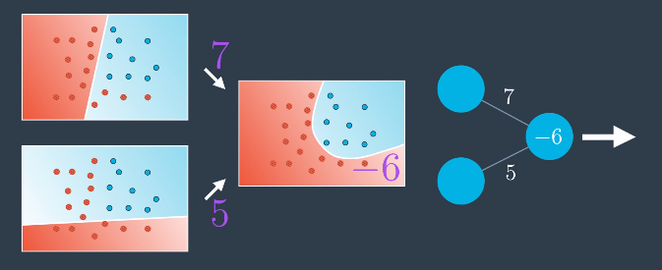
Understanding what NNs actually do
Combining Multiple Perceptrons

Slide 34
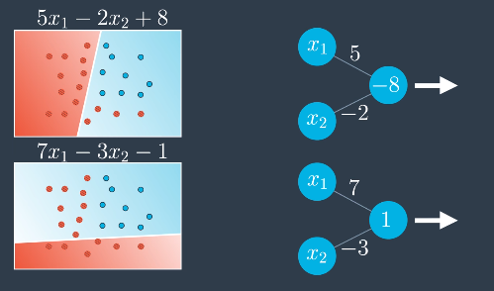
Understanding what NNs actually do
Combining Multiple Perceptrons - Take two perceptrons

Slide 35
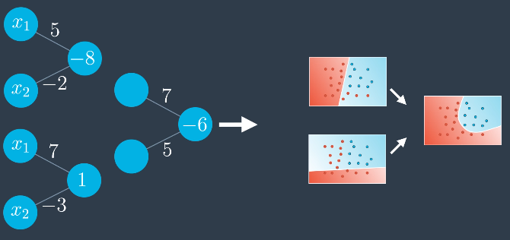
Understanding what NNs actually do
Combining Multiple Perceptrons - Take 2 perceptrons and combine their output with a 3rd perceptron

Slide 36
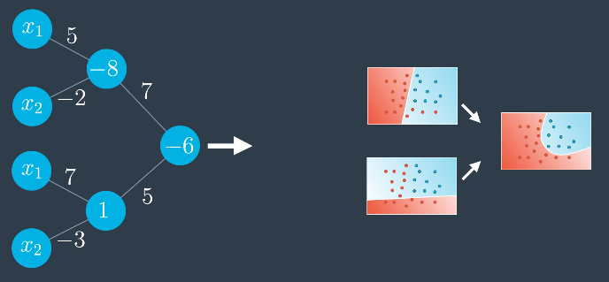
Understanding what NNs actually do
Combining Multiple Perceptrons - Take 2 perceptrons and combine their output with a 3rd perceptron

Slide 37
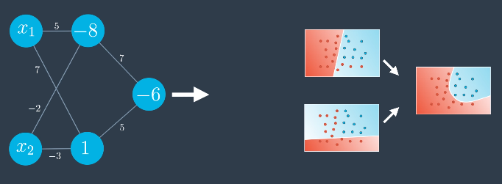
Understanding what NNs actually do
Combining Multiple Perceptrons - Take 2 perceptrons and combine their output with a 3rd perceptron - Clean up the diagram

Slide 38
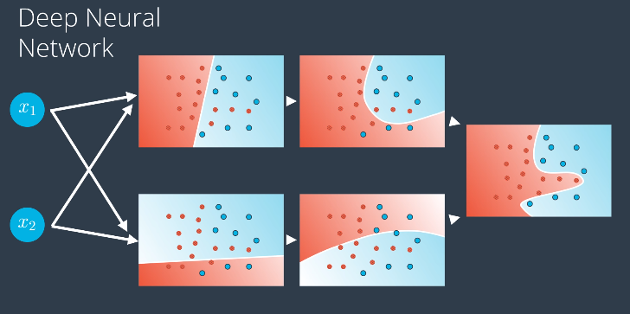
Understanding what NNs actually do
Add more layers of perceptrons in the middle - You get the Deep Neural Network!

Slide 39
Understanding what NNs actually do
DNNs can approximate ANY non-linear function - This is when the perceptrons go super saiyan!

Slide 40

Understanding what NNs actually do
DNNs can approximate ANY non-linear function - This is when the perceptrons go super saiyan! - Kamehameha moment!

Slide 41

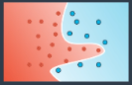
Understanding what NNs actually do
AI is going to take over the world.
LOL! Poor thing is just finding lines that best fit/classify the data.

Slide 42
A more Mathematical Approach
Alas! Training and evaluating the combination of perceptrons (the Deep Neural Network) is not that straightforward.

Slide 43
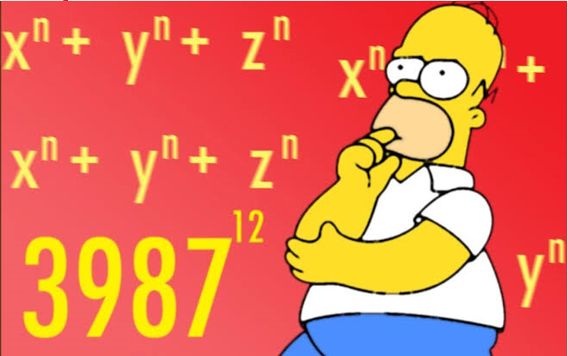
A more Mathematical Approach
Alas! Training and evaluating the combination of perceptrons (the Deep Neural Network) is not that straightforward.
We dive into the maths now.

Slide 44
A more Mathematical Approach
How we numerically calculate the Deep Neural Network Output?

Slide 45
A more Mathematical Approach
How we numerically calculate the Deep Neural Network Output?
Feedforward!

Slide 46
A more Mathematical Approach - Feedforward
At the end of the day, NNs contain…..?

Slide 47

A more Mathematical Approach - Feedforward
At the end of the day, NNs contain…..?

Slide 48
A more Mathematical Approach - Feedforward
At the end of the day, NNs contain
Inputs
Weights
Input to hidden1
Hidden1 to hidden 2
Hidden 2 to output
Hidden Layers
Hidden Layer 1
Hidden Layer 2
Output (only 1 in this case)

Slide 49
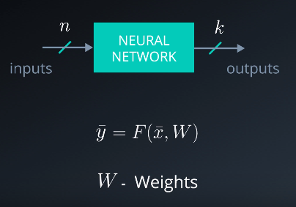
A more Mathematical Approach - Feedforward
Now we can describe a NN like a black box
Inputs - x1 to xn - x_bar (i/p vector)
Weights - W (matrix)
Output - y1 to yk - y_bar (o/p vector)
F is a non-linear function
Neural Network as a Universal Non-linear Function Approximator.

Slide 50
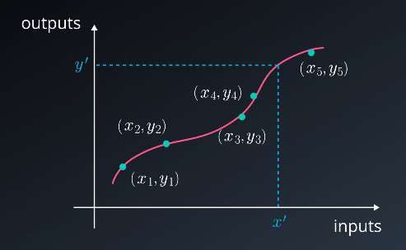
A more Mathematical Approach - Feedforward
Now we can describe a NN like a black box
Inputs - x1 to xn - x_bar (i/p vector)
Weights - W (matrix)
Output - y1 to yk - y_bar (o/p vector)
F is a non-linear function
Neural Network as a Universal Non-linear Function Approximator.

Slide 51
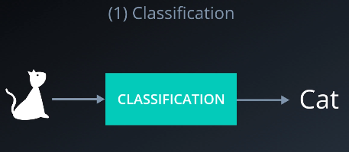
A more Mathematical Approach - Feedforward
Now we can describe a NN like a black box
Inputs - x1 to xn - x_bar (i/p vector)
Weights - W (matrix)
Output - y1 to yk - y_bar (o/p vector)
F is a non-linear function
Neural Network as a Universal Non-linear Function Approximator
Classification

Slide 52
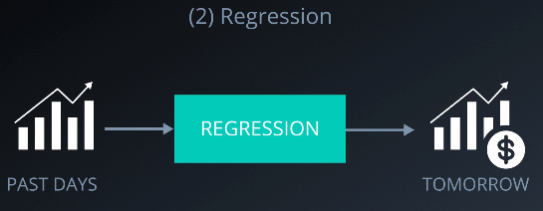
A more Mathematical Approach - Feedforward
Now we can describe a NN like a black box
Inputs - x1 to xn - x_bar (i/p vector)
Weights - W (matrix)
Output - y1 to yk - y_bar (o/p vector)
F is a non-linear function
Neural Network as a Universal Non-linear Function Approximator
Classification
Regression

Slide 53
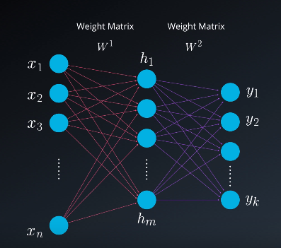
A more Mathematical Approach - Feedforward
A generic Deep NN

Slide 54
A more Mathematical Approach - Feedforward
A generic Deep NN
What is weight matrix?!?!

Slide 55
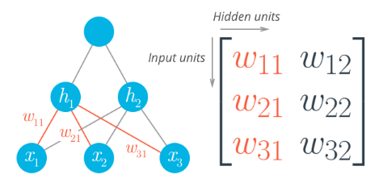
A more Mathematical Approach - Feedforward
A generic Deep NN
What is weight matrix?!?!

Slide 56
A more Mathematical Approach - Feedforward
Input Units/rows - Weights originating from layer hp
Hidden Units/columns - no of nodes in layer hp+1

Slide 57
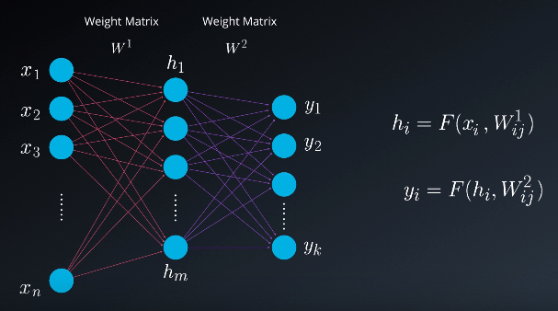
A more Mathematical Approach - Feedforward
A simple feedforward

Slide 58
A more Mathematical Approach - Feedforward
A simple feedforward
How each neuron is looks like?

Slide 59
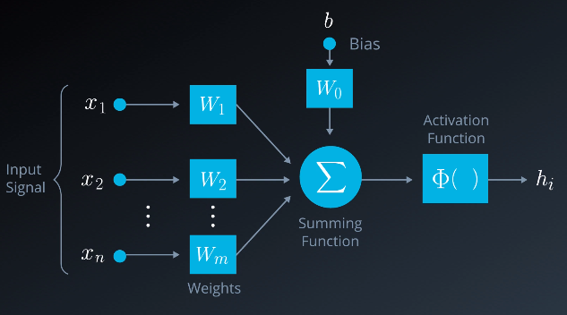
A more Mathematical Approach - Feedforward
A simple feedforward
How each neuron is looks like?

Slide 60
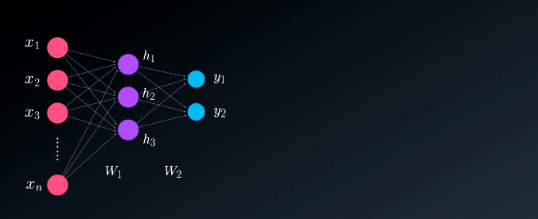
A more Mathematical Approach - Feedforward
A simple feedforward

Slide 61
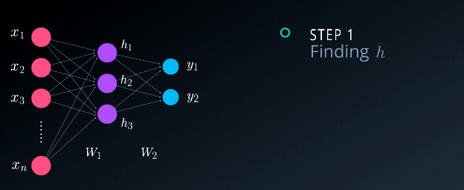
A more Mathematical Approach - Feedforward
A simple feedforward

Slide 62
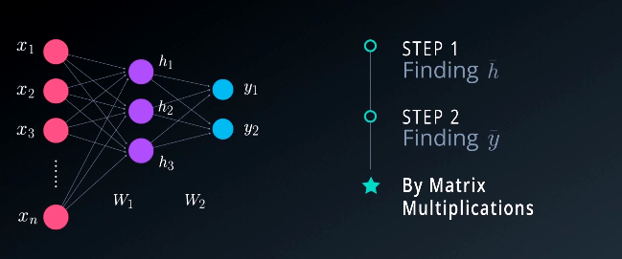
A more Mathematical Approach - Feedforward
A simple feedforward

Slide 63
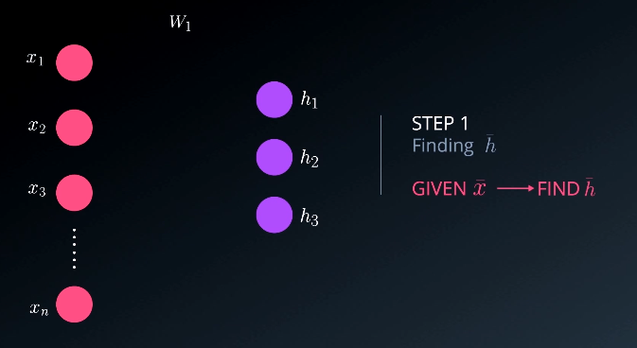
A more Mathematical Approach - Feedforward
A simple feedforward

Slide 64
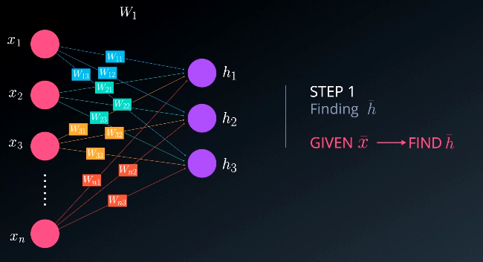
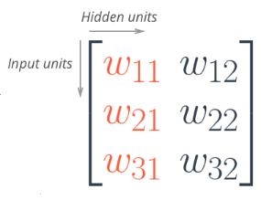
A more Mathematical Approach - Feedforward
A simple feedforward

Slide 65
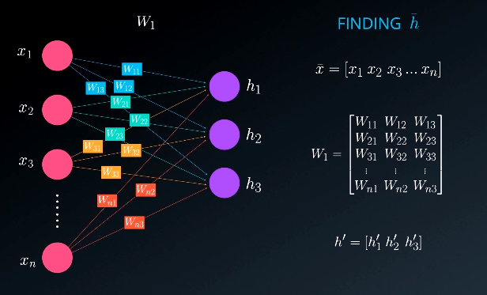
A more Mathematical Approach - Feedforward
A simple feedforward

Slide 66
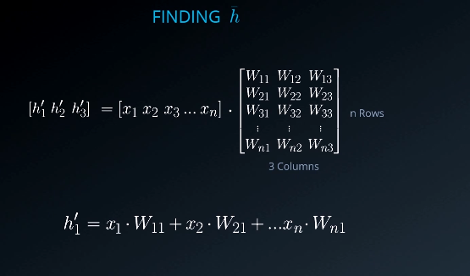
A more Mathematical Approach - Feedforward
A simple feedforward

Slide 67
A more Mathematical Approach - Feedforward
A simple feedforward
Need to apply an activation function

Slide 68
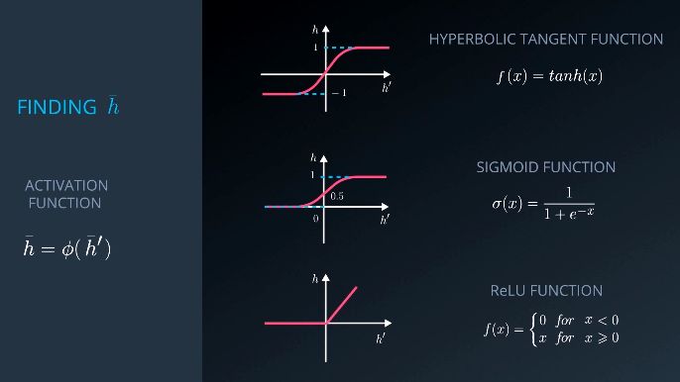
A more Mathematical Approach - Feedforward
A simple feedforward
Activation Functions

Slide 69
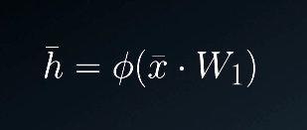
A more Mathematical Approach - Feedforward
A simple feedforward

Slide 70
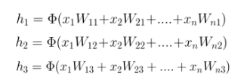
A more Mathematical Approach - Feedforward
A simple feedforward

Slide 71
A more Mathematical Approach - Feedforward
A simple feedforward
Now we calculate y

Slide 72
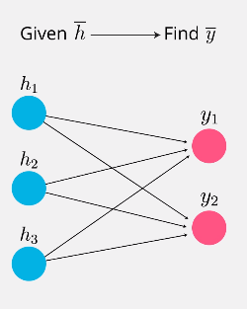
A more Mathematical Approach - Feedforward
A simple feedforward
Now we calculate y

Slide 73
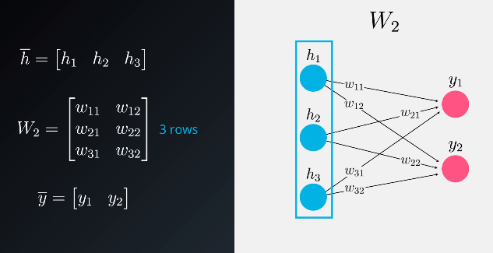
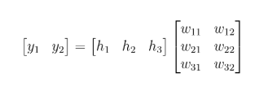
A more Mathematical Approach - Feedforward
A simple feedforward
Now we calculate y

Slide 74
A more Mathematical Approach - Feedforward
A simple feedforward

Slide 75
A more Mathematical Approach - Feedforward
OK! We know how to calculate the output of a DNN.
But what we do if it gives the wrong output?!?!
First, define How Wrong the Output is.
Define an Error.

Slide 76
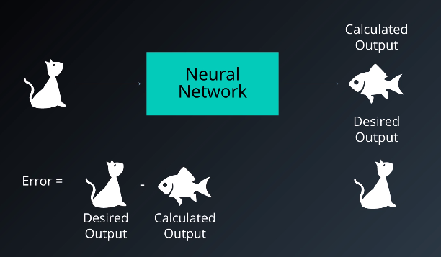
A more Mathematical Approach - Error
Error

Slide 77

A more Mathematical Approach - Error
Error - More Formally

Slide 78

A more Mathematical Approach - Error
We want to adjust the weights so that our error is Minimized.
The Best Weights!

Slide 79
A more Mathematical Approach - Error
We want to adjust the weights so that our error is Minimized.
The Best Weights!
Essentially, we wish to find how y/error is changing with respect to the weights.

Slide 80
A more Mathematical Approach - Error
We want to adjust the weights so that our error is Minimized.
The Best Weights!
Essentially, we wish to find how y/error is changing with respect to the weights.

Slide 81
A more Mathematical Approach - Error
…...y/error is changing with respect to the weights.

Slide 82
A more Mathematical Approach - Error
….a function f(y) is changing with respect to x.

Slide 83
A more Mathematical Approach - Error
….a function f(y) is changing with respect to x.
:DRUMROLLS:

Slide 84
A more Mathematical Approach - Error
….a function f(y) is changing with respect to x.
:DRUMROLLS:
*Partial Differential Calculus Incoming

Slide 85

A more Mathematical Approach - Error
….a function f(y) is changing with respect to x.
:DRUMROLLS:
*Partial Differential Calculus Incoming

Slide 86

A more Mathematical Approach - Gradient Descent
Assume we have only one neuron.
Only one weight w.

Slide 87

A more Mathematical Approach - Gradient Descent
3 neurons - 3 weights.
We need to find the best combination.

Slide 88

A more Mathematical Approach - Gradient Descent
3 neurons - 3 weights.
We need to find the best combination.

Slide 89


A more Mathematical Approach - Gradient Descent
More precisely

Slide 90


A more Mathematical Approach - Gradient Descent
Inverse Relation between weights and Gradient

Slide 91

A more Mathematical Approach - Backpropagation Intuition
A look back at our network

Slide 92

A more Mathematical Approach - Backpropagation Intuition
A look back at our network -Weight Update Step

Slide 93

A more Mathematical Approach - Backpropagation Intuition
A look back at our network -Weight Update Step - Backpropagate

Slide 94


Slide 95

A more Mathematical Approach - Backpropagation Intuition
Gradient Descent vs Backpropagation

Slide 96
Sorry, I ran out of time.

